Slide 1

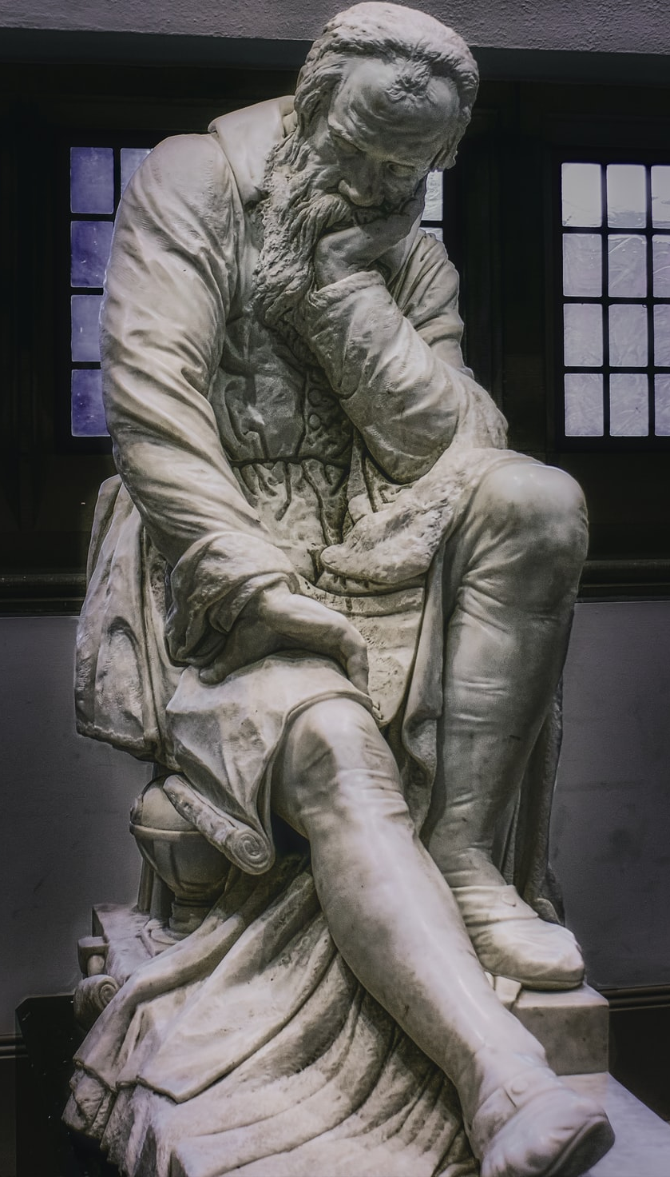
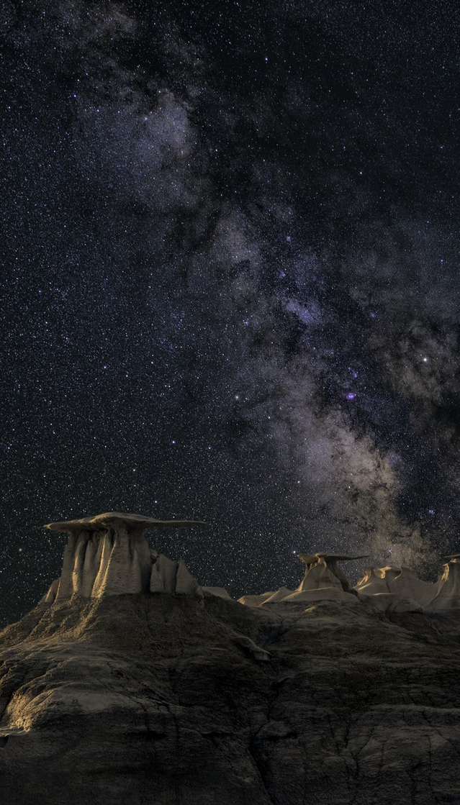
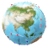
An Orbit Around the Life of Galileo Galilei
LADC Presentation by
Group 1
Krishnaraj, Devanshu, Parth, Pranaav, Tirth and Pranav

Slide 2
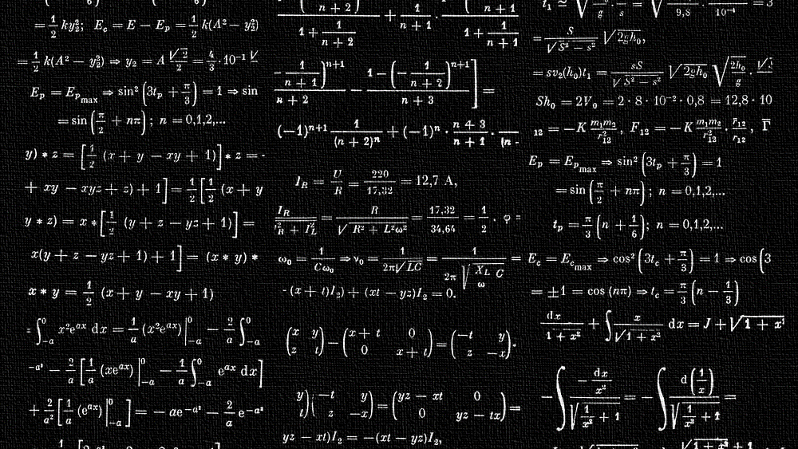
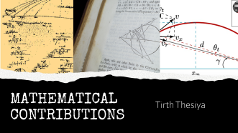
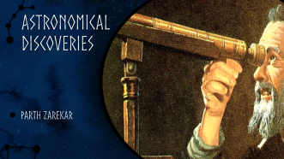
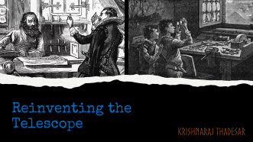

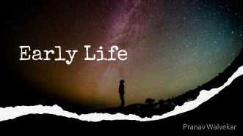
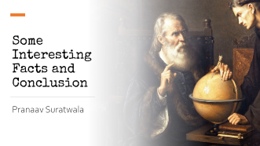
Contents

Slide 3
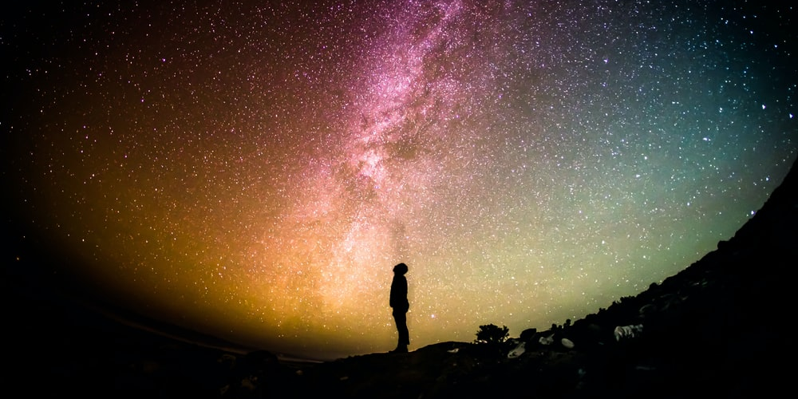
Early Life
Pranav Walvekar

Slide 4
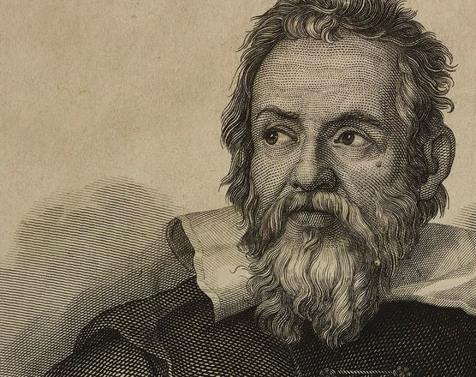
So Who was Galileo ?
Born in 1564, in Pisa, Italy, Galileo was a natural philosopher, astronomer, and mathematician who made fundamental contributions to the sciences of motion, astronomy, and strength of materials and to the development of the scientific method

Slide 5
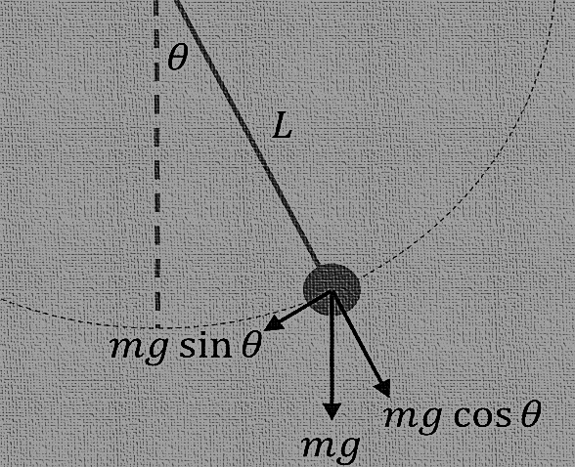
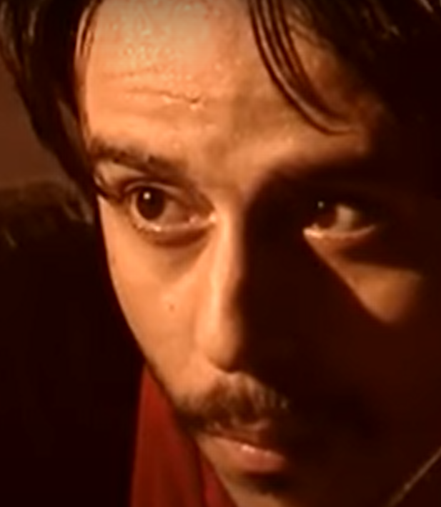
Why is he Famous?
Galileo Accomplished many things, but he was most famous for reinventing the telescope, Calculating Pendulum Equations with his experiments, and Discovering the orbits of Moons around Jupiter.

Slide 6
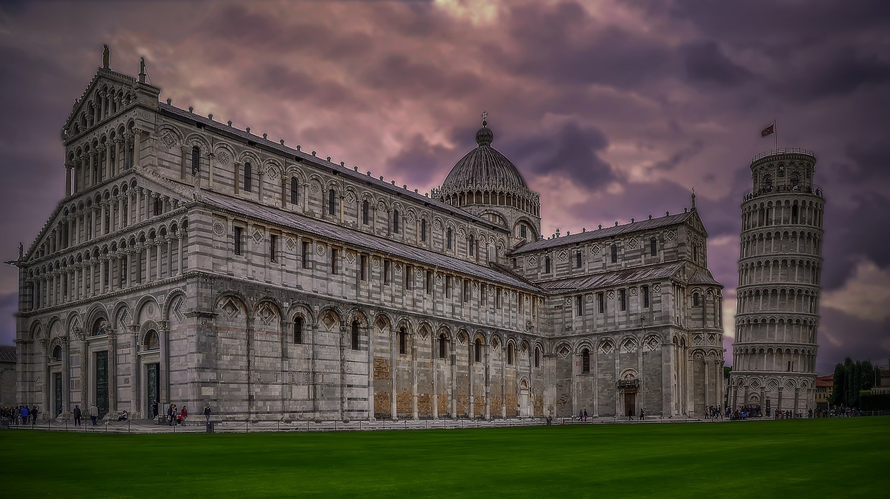
Educational Background
Devanshu Surana

Slide 7
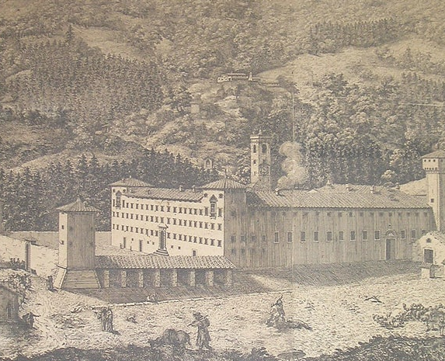
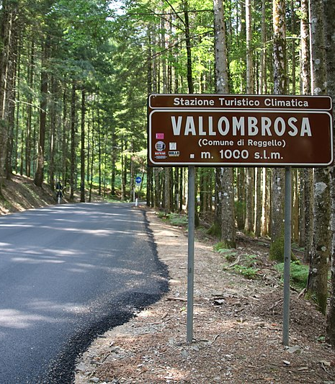
Alma Mater
Galileo Galilei was educated at the Camaldolese Monastery at Vallombrosa. In 1581 he was sent by his father to enroll for a medical degree at the University of Pisa.

Slide 8
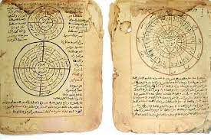
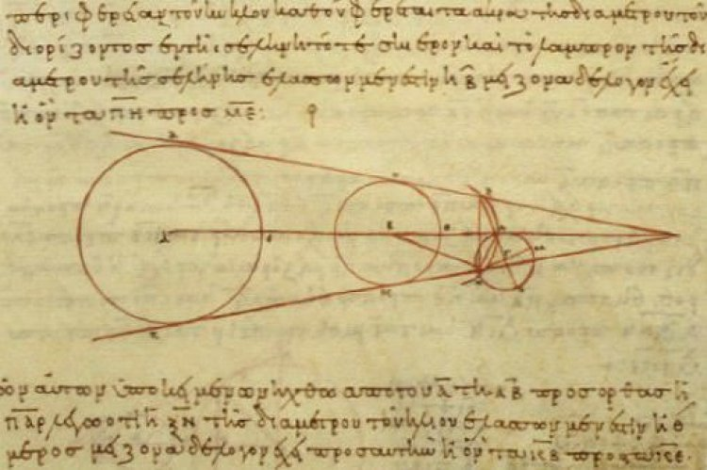
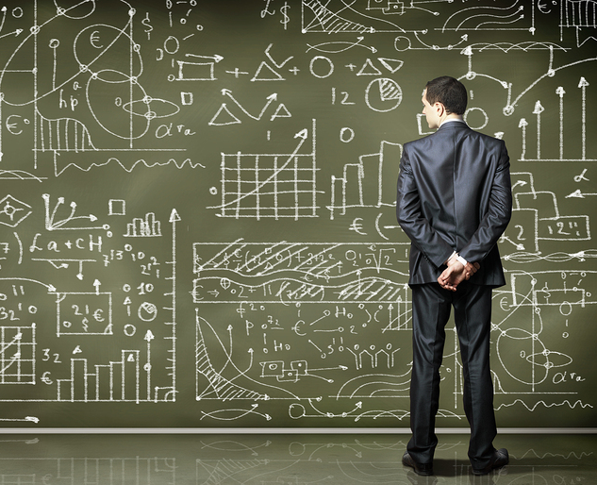
Interest in Mathematics
Galileo never seems to have taken medical studies seriously, attending courses on his real interests which were in mathematics and natural philosophy. He left Pisa in 1585 without completing his medical degree and began teaching mathematics in Florence and later at Siena.

Slide 9
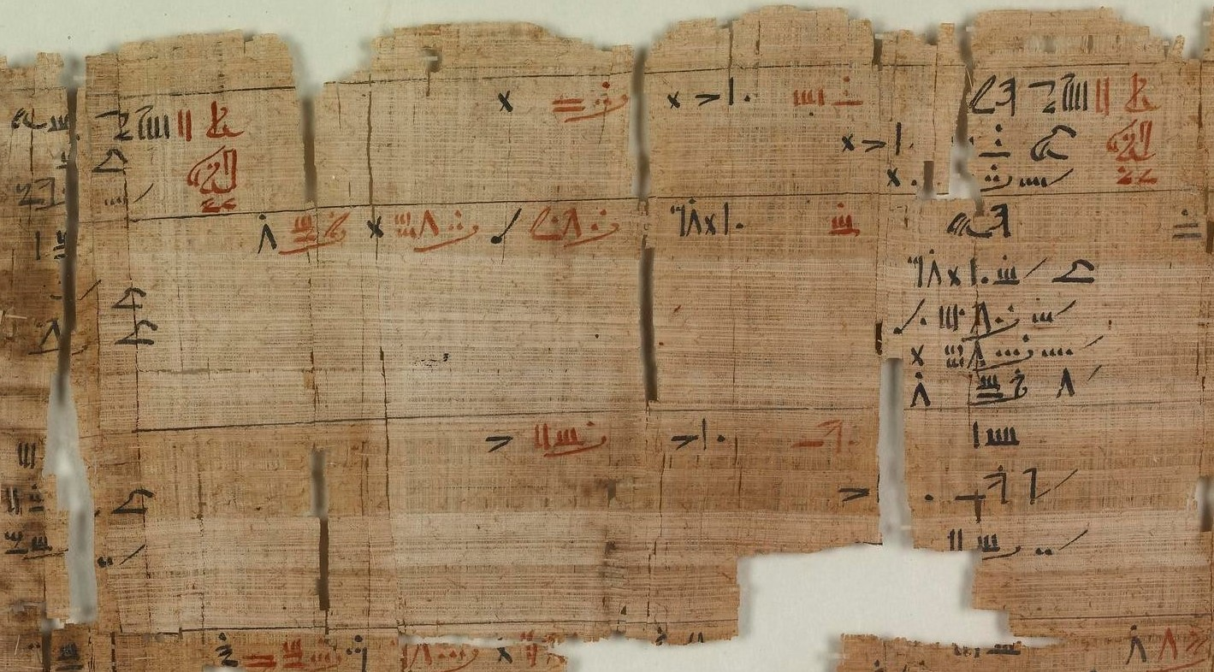
The Pendulum and Pursuit of Math
In 1581, when he was studying medicine, he noticed a swinging chandelier, which air currents shifted about to swing in larger and smaller arcs.
Up to this point, Galileo had deliberately been kept away from mathematics, since a physician earned a higher income than a mathematician. However, after accidentally attending a lecture on geometry, he talked his reluctant father into letting him study mathematics and natural philosophy instead of medicine.

Slide 10
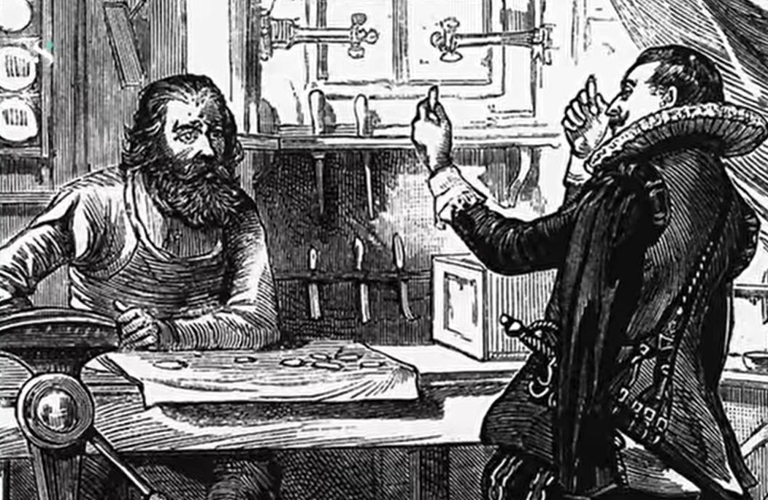
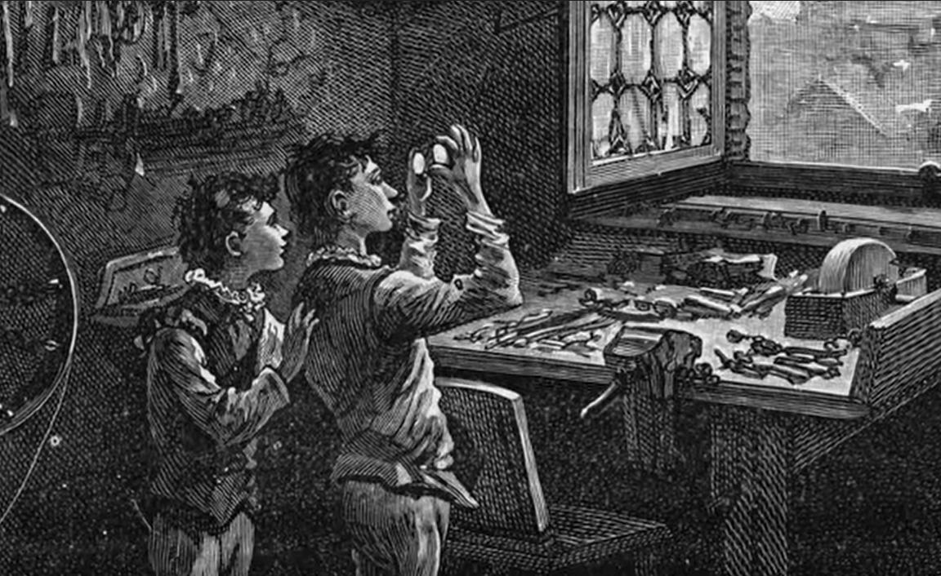
Reinventing the Telescope
Krishnaraj Thadesar

Slide 11
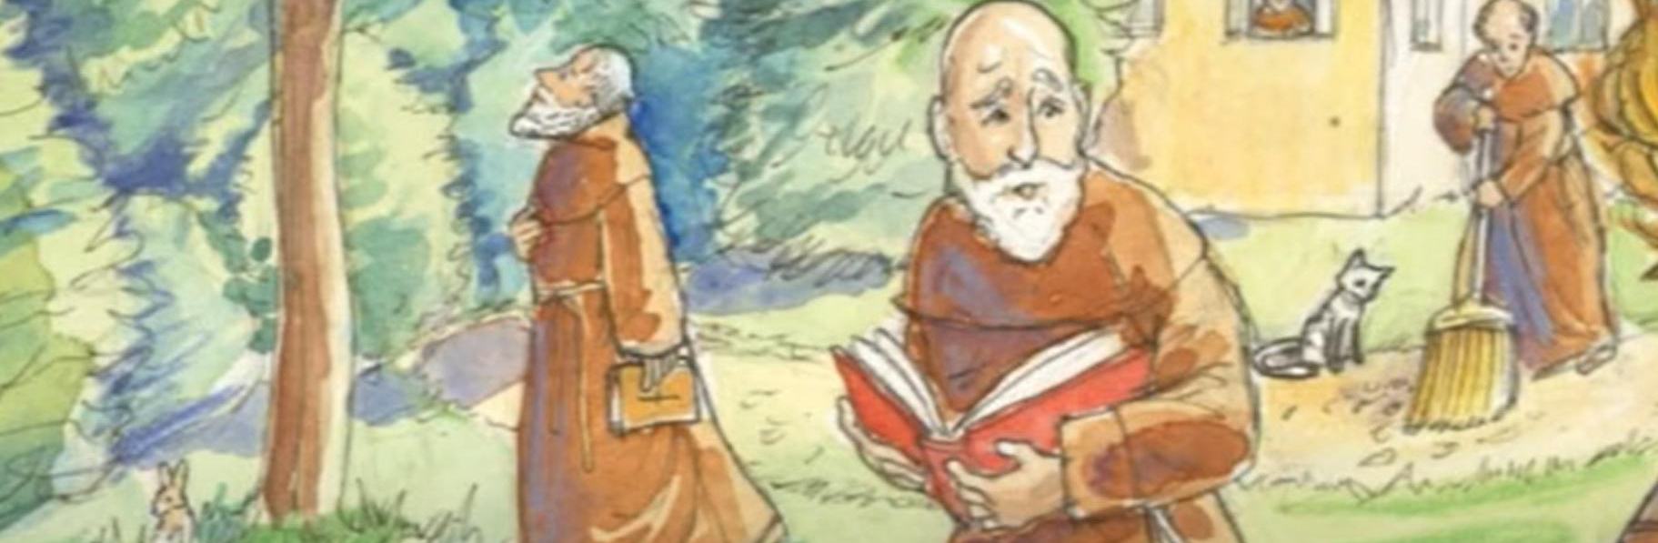
He was just another person
But his father had passed away early, and so now the responsibility of the entire family and marrying 2 of his sisters was on him.

Slide 12
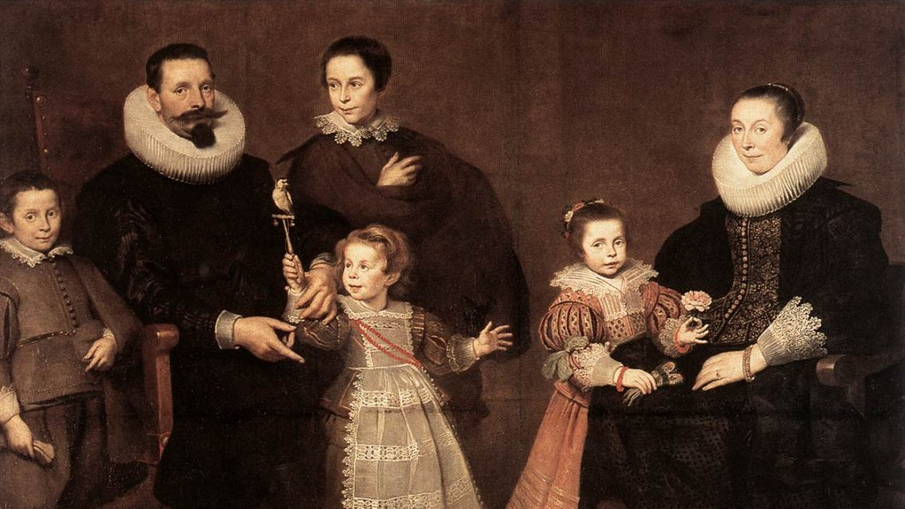
Owed Dowry Money to His brother in laws
And so he always looked for ways to quickly make money

Slide 13
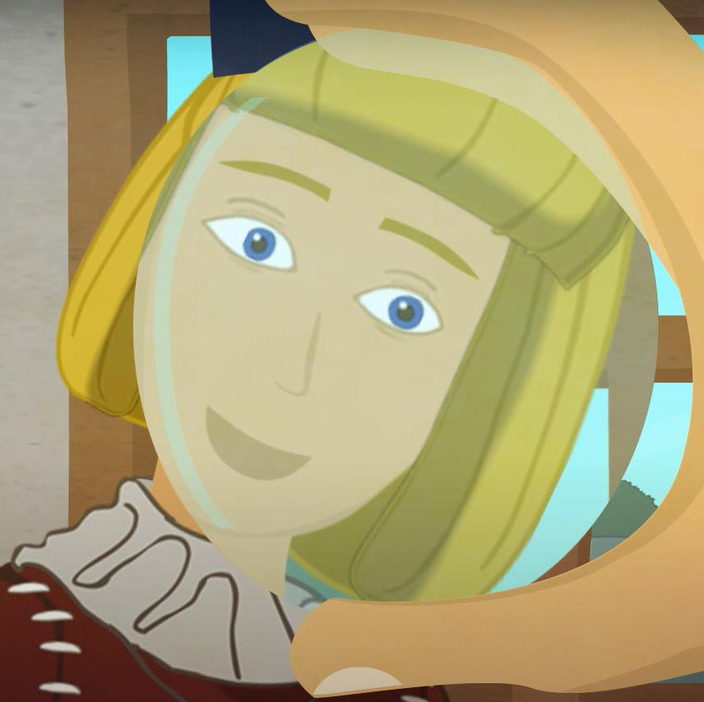
In the Summer of 1609, the Danish Glass was a popular Buzz
It was this new toy that made you see farther things clearly. Some form of magic to most people. But a desperate Galileo somehow found the opportunity to make quick money here.

Slide 14
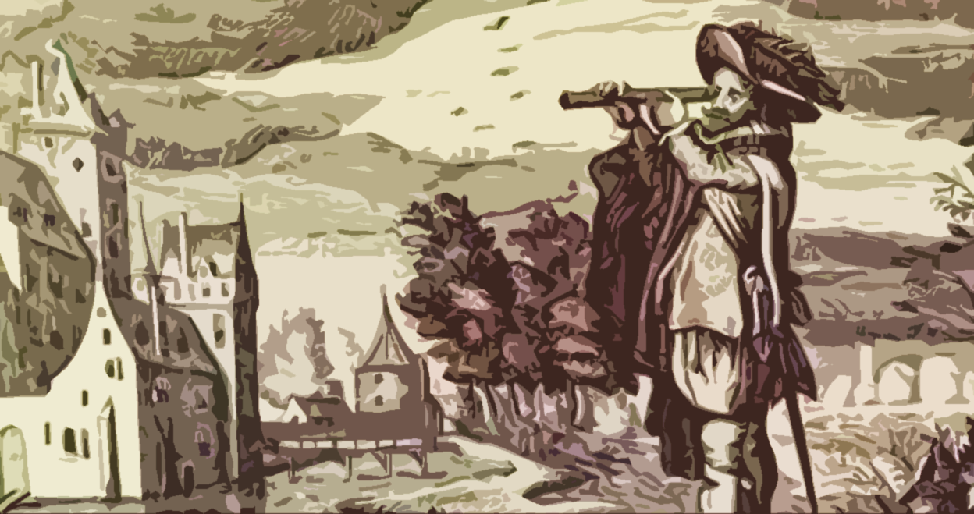
Improving the Telescope
He Improves the Design, while in desperate need of money, so he can find a useful application to sell.

Slide 15
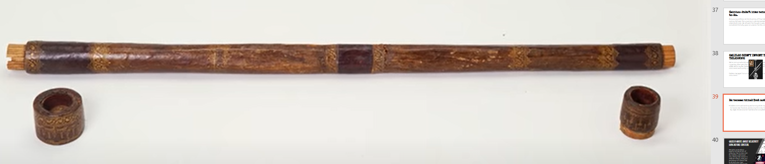
Pic of the telescope he made

Slide 16
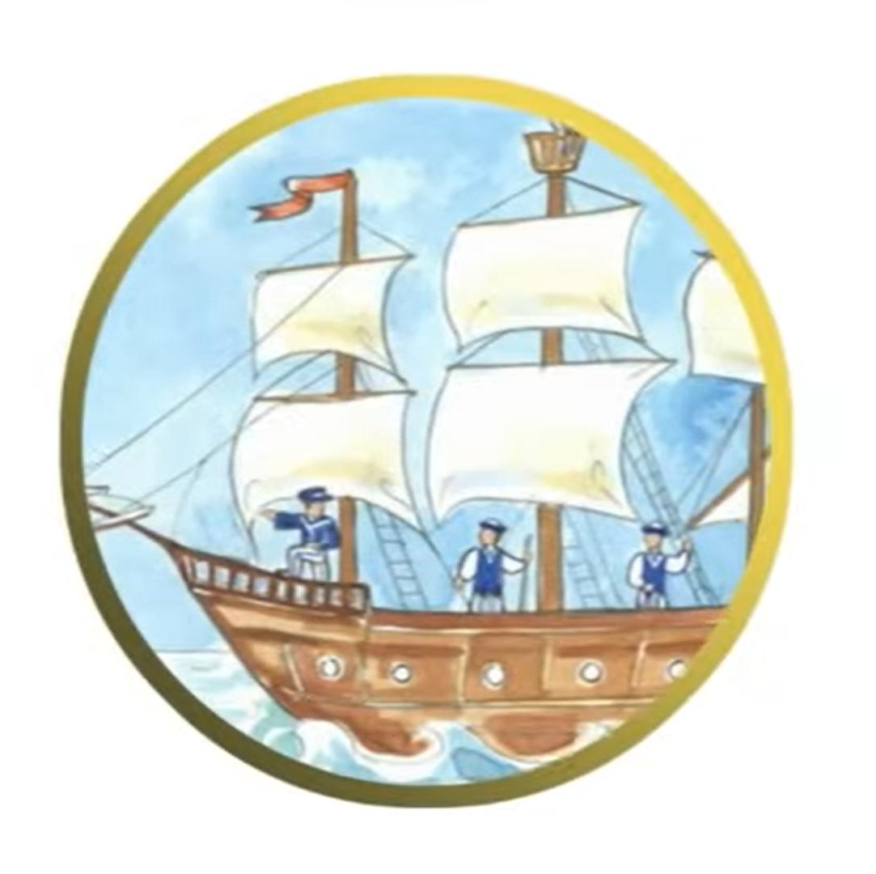
Selling to the Duke and the King
He now reduced the time needed to know if an enemy ship was approaching the coast by 2 hours in comparison to the Naked eye. This was far too economical an invention, and so he secured a job for life, at twice his previous salary as a Math Professor.

Slide 17
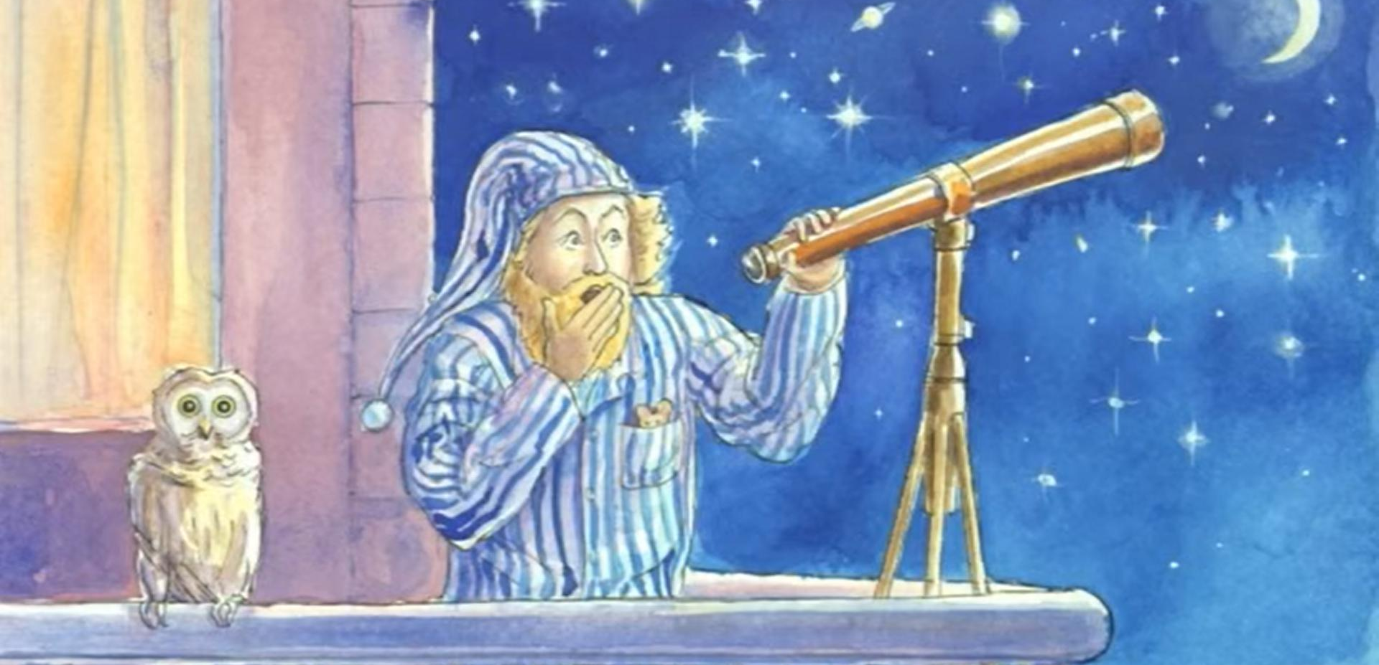
With the new money, came a better telescope, and better discoveries

Slide 18
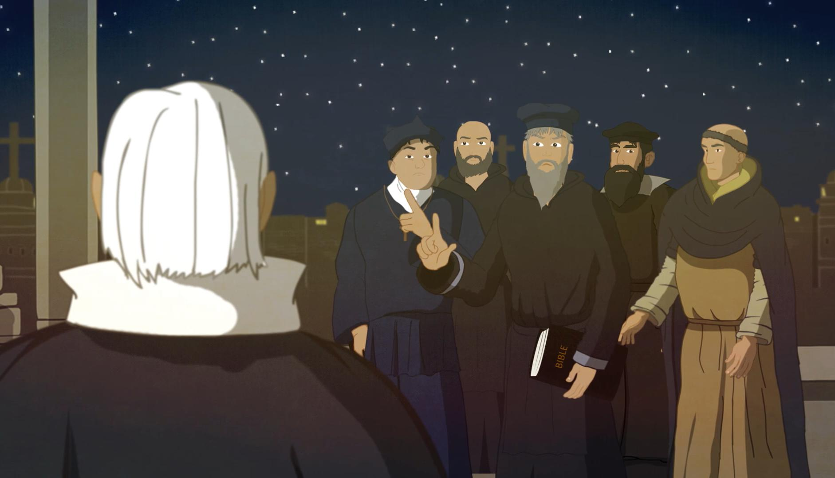
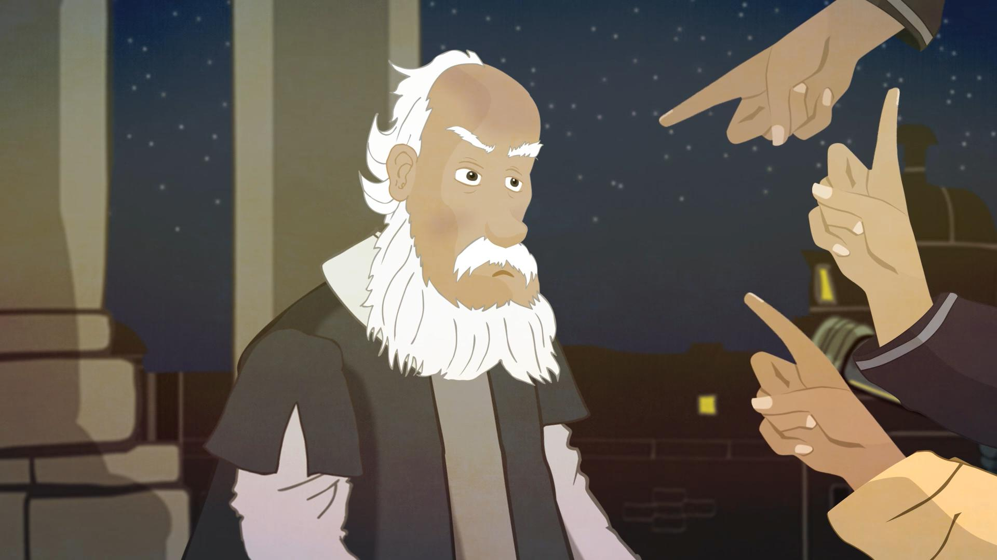
He Observed the Heavens, which the church didn’t like….

Slide 19
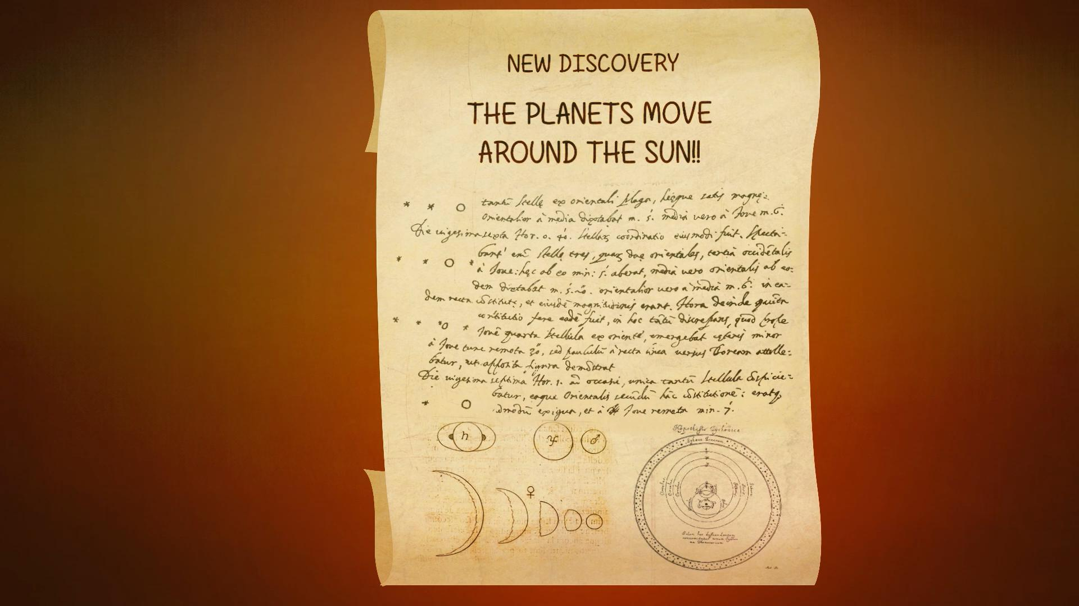
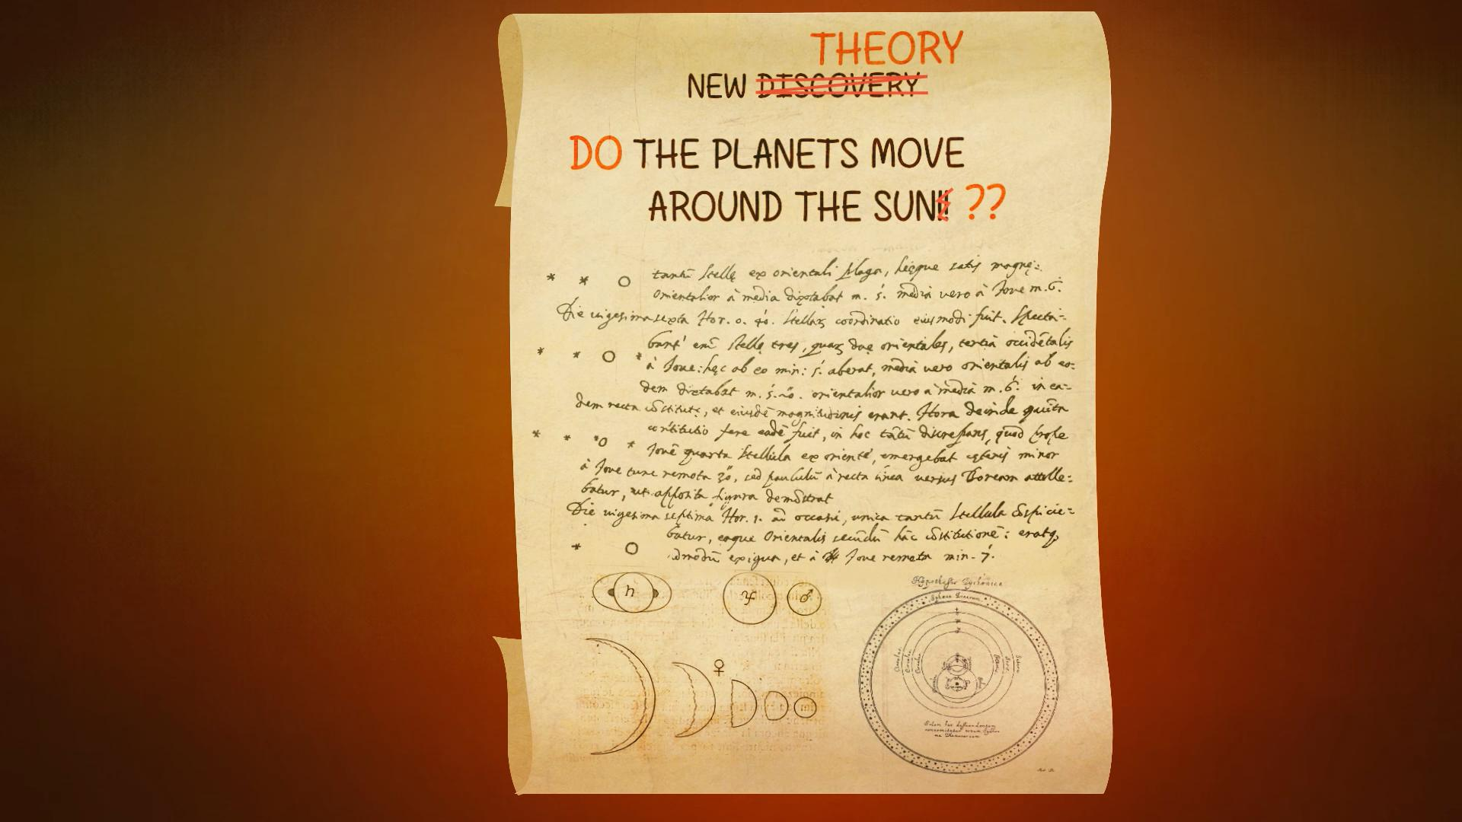
“Only God can see the Heavens”

Slide 20
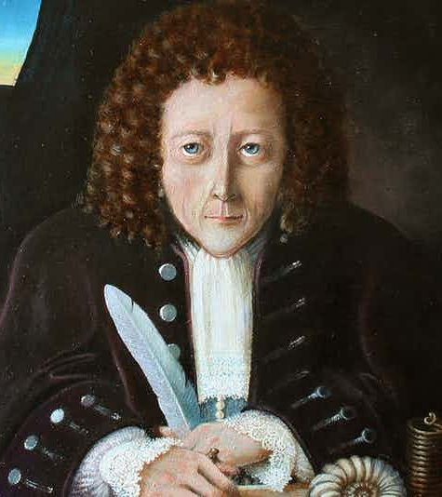
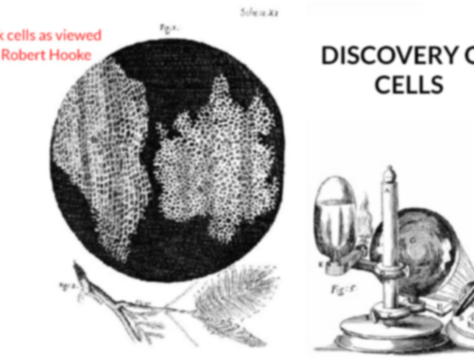
What if someone looked from the other side of the Telescope?
Robert Hooke and creation of a new field of cell Biology.

Slide 21
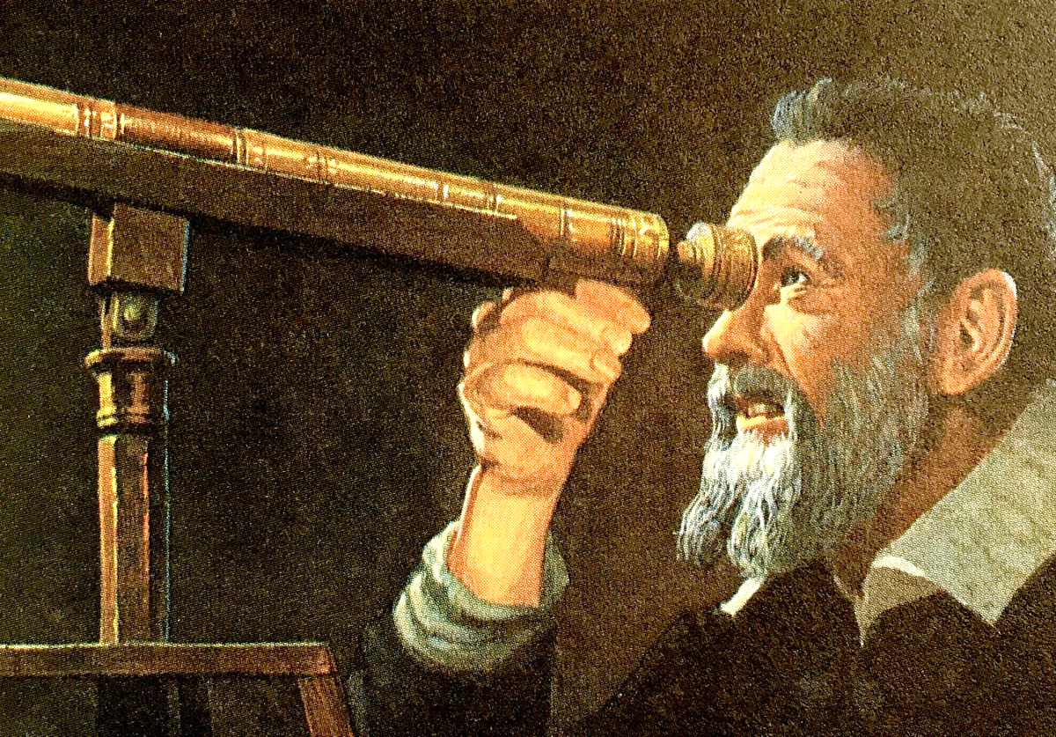
Astronomical Discoveries
Parth Zarekar

Slide 22
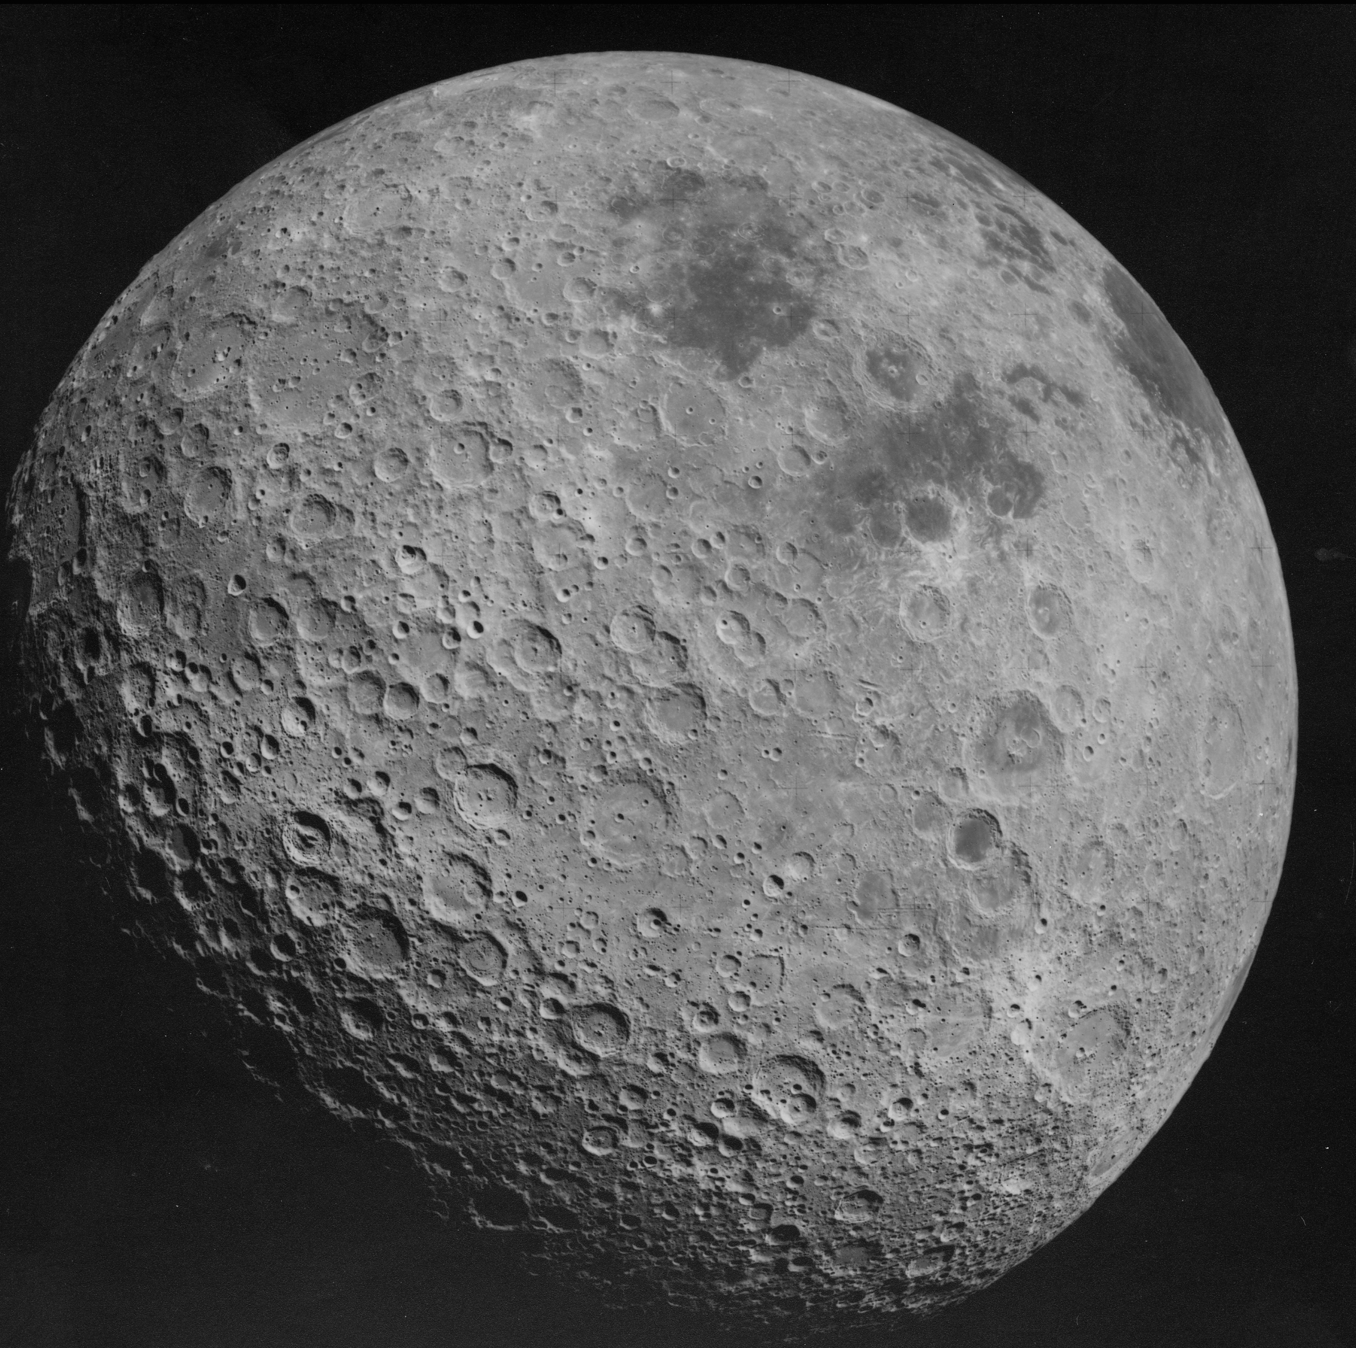
Observing the Reality of the Moon
Mountains
Craters
Lunar Mountains

Slide 23
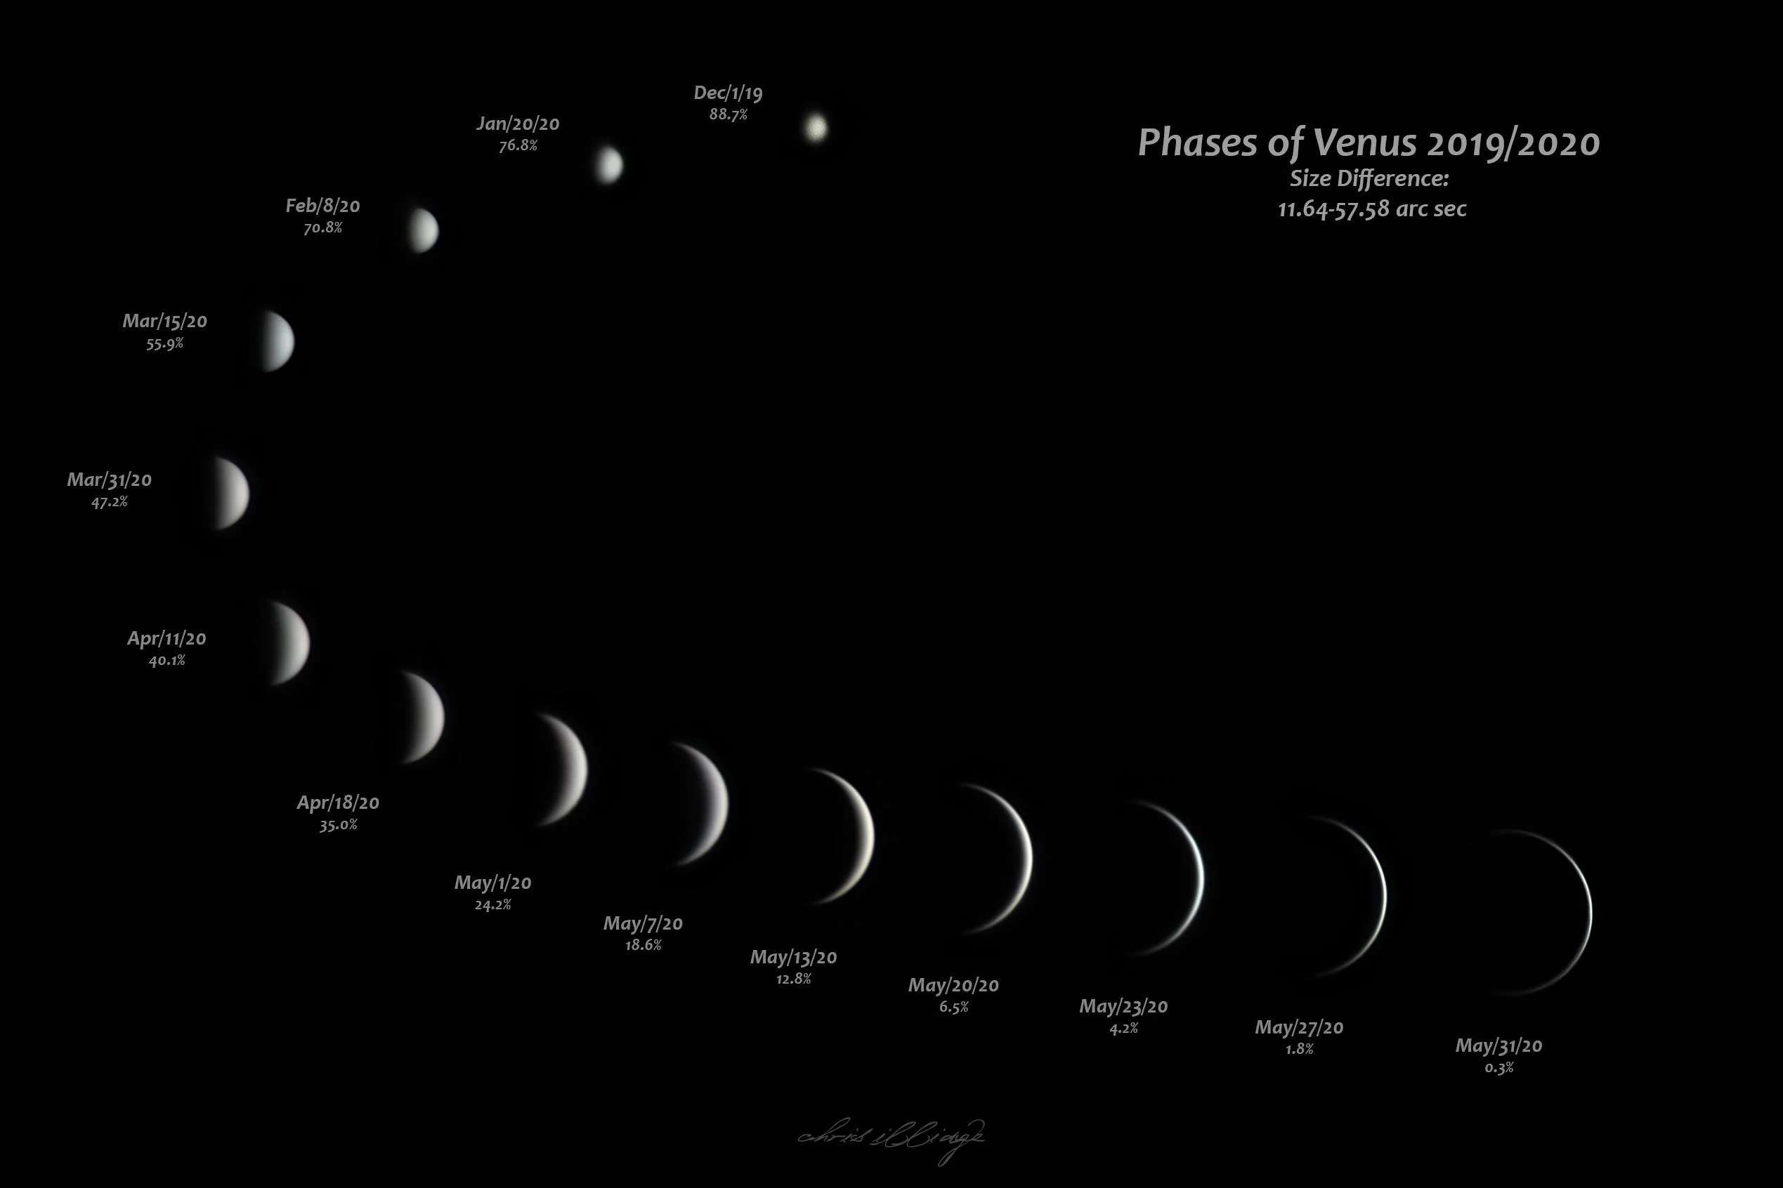
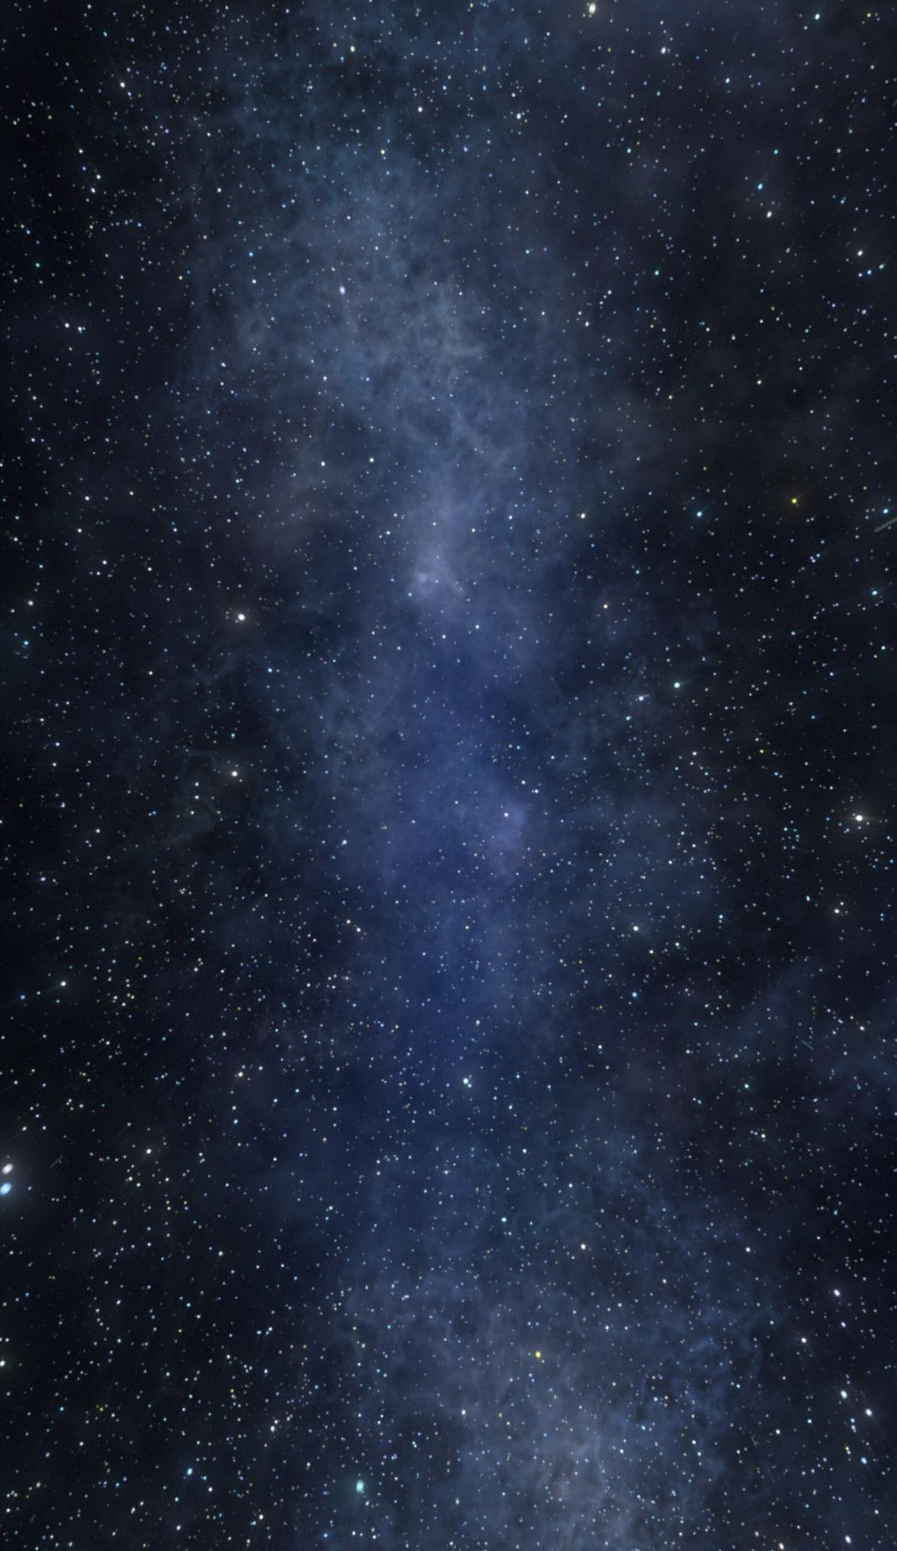
Phases Of Venus

Slide 24
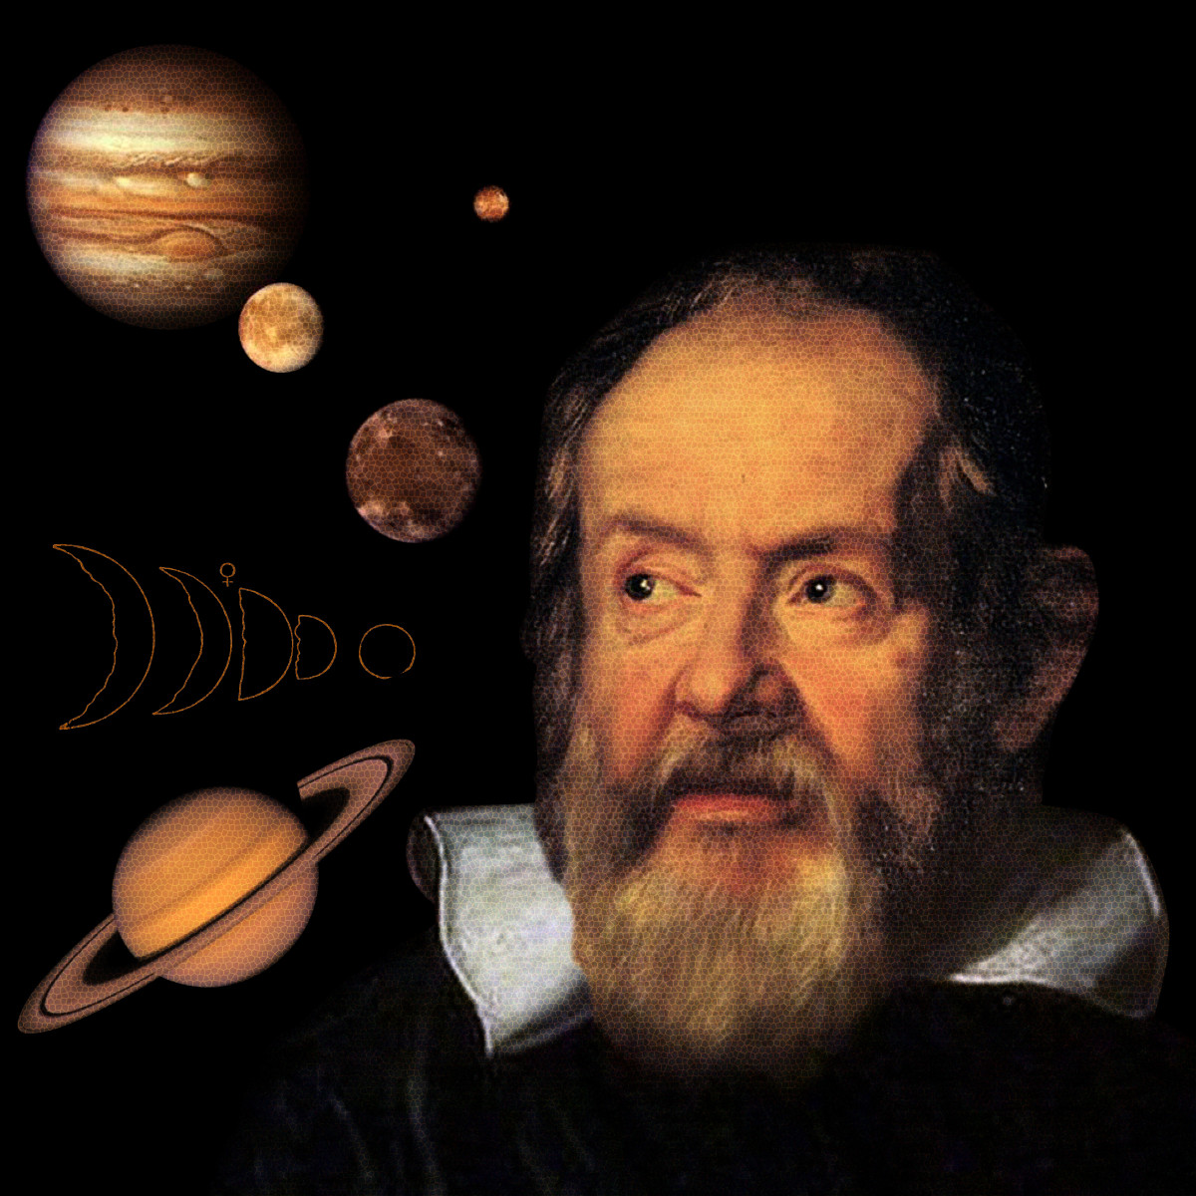
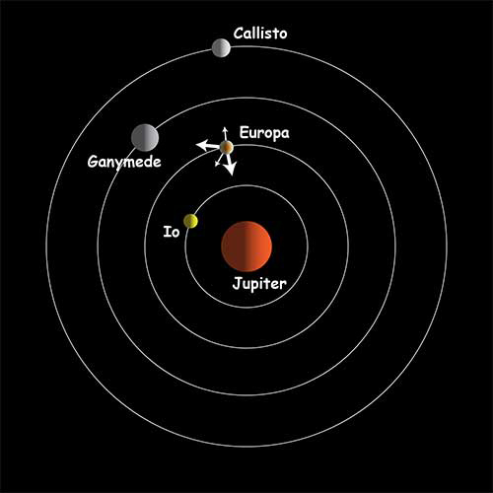
Discovery of Jupiter and its moon’s.

Slide 25
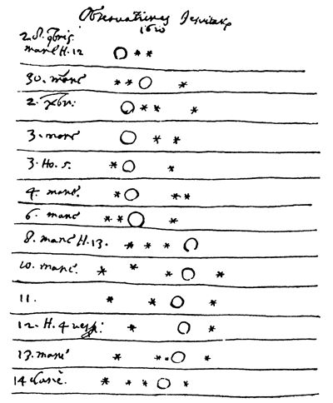
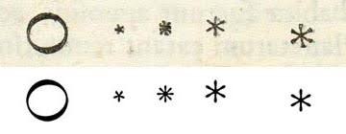
The Drawings in his note

Slide 26
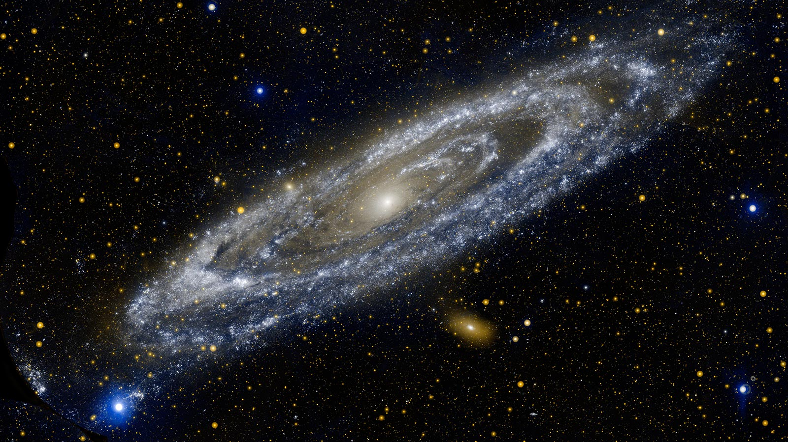
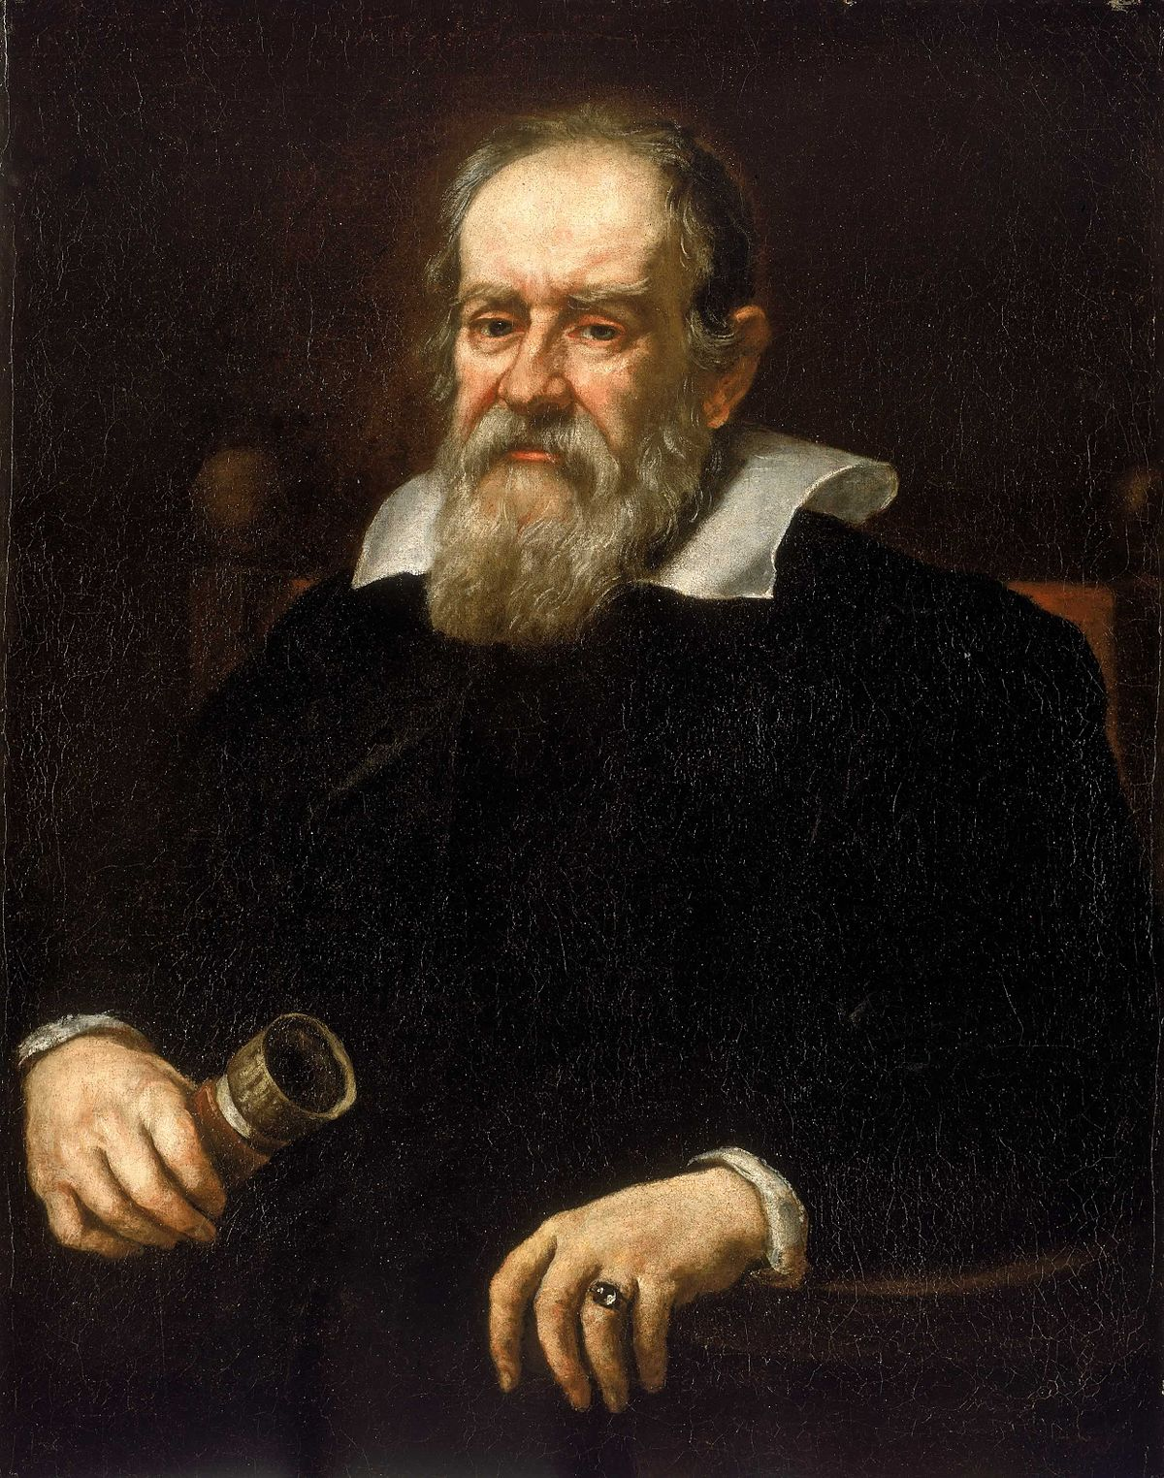

Slide 27
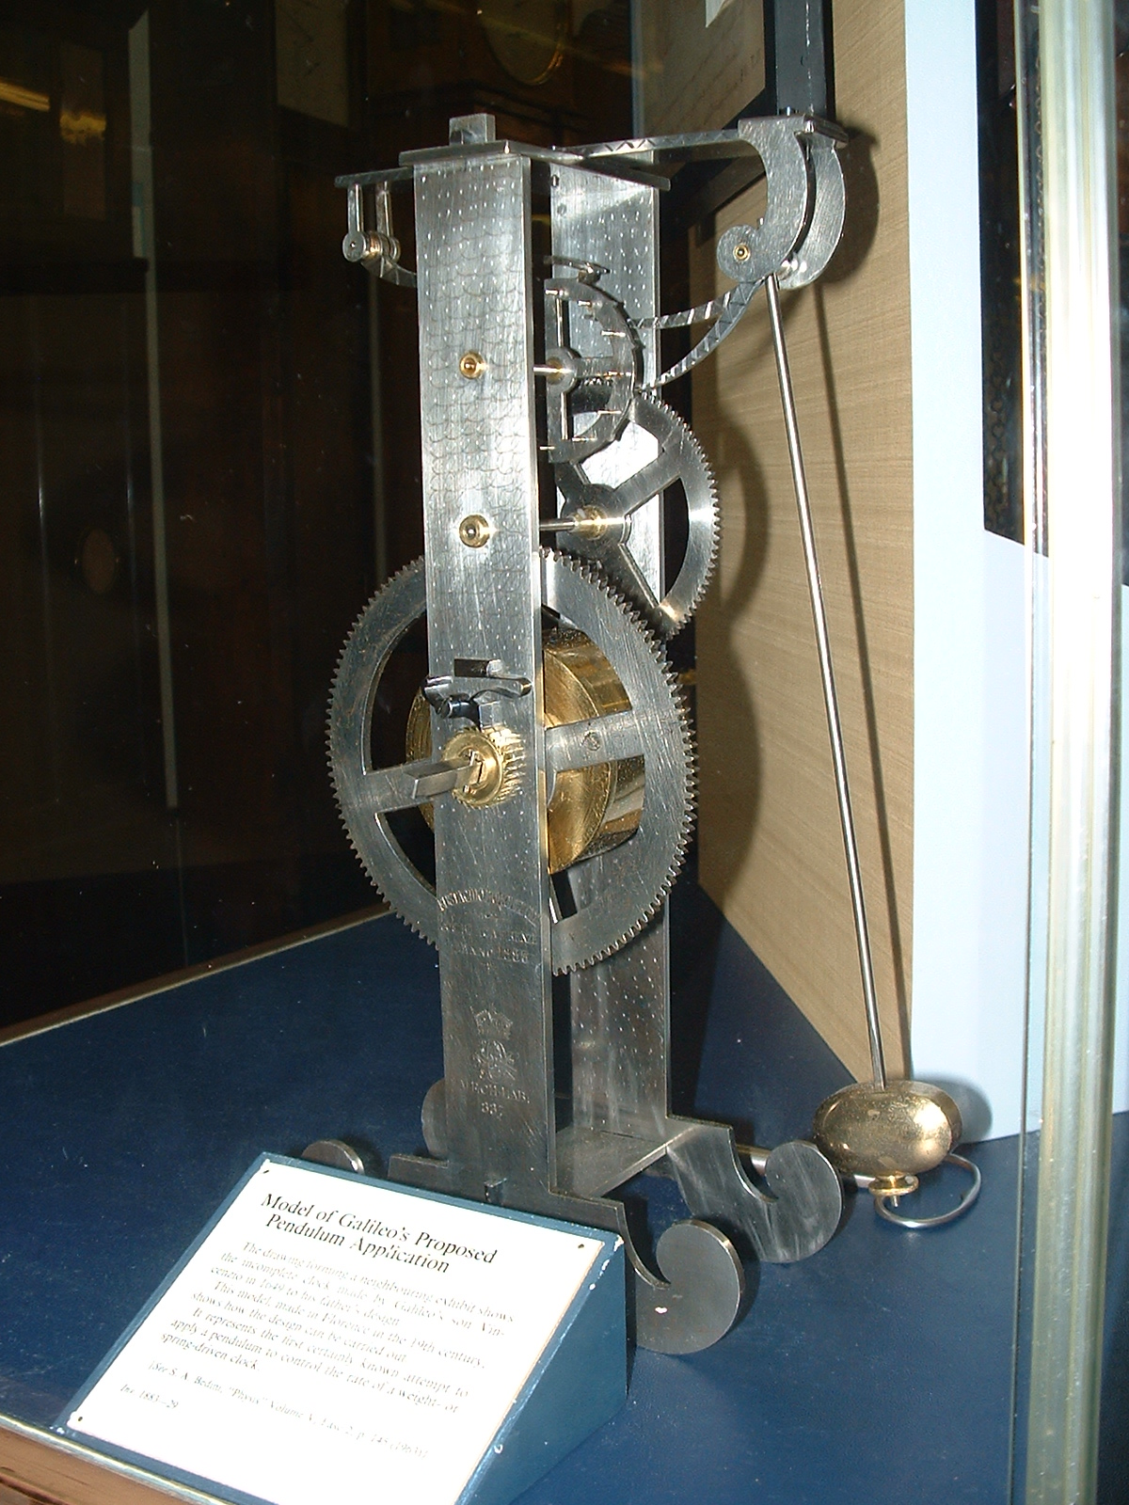
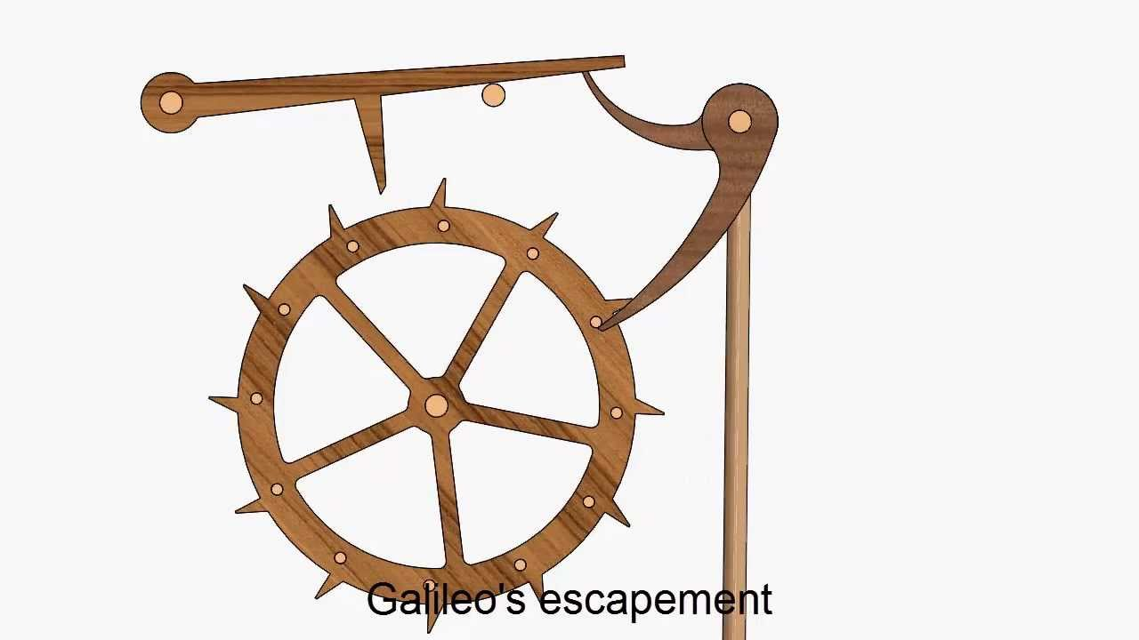

Slide 28
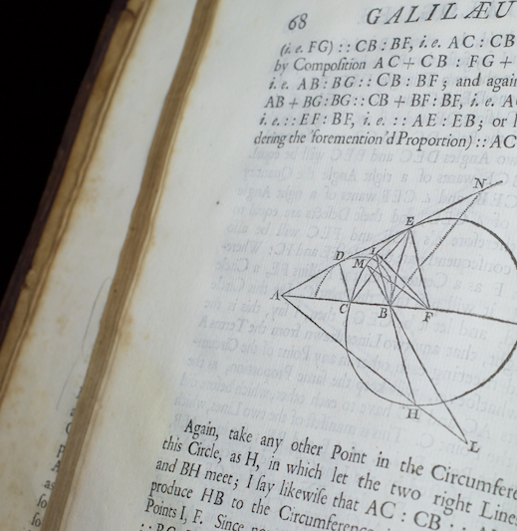
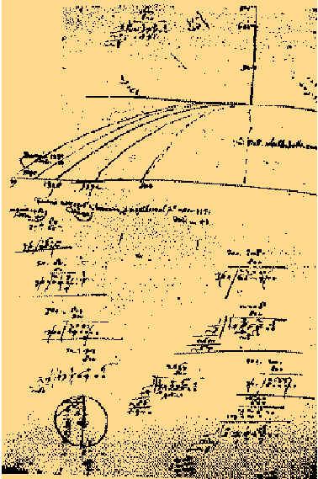
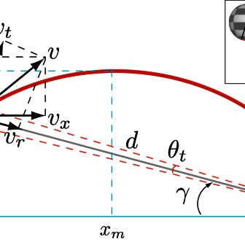
MATHEMATICAL CONTRIBUTIONS
Tirth Thesiya

Slide 29


The Pendulum
Galileos clock which works on principle of pendulum .
The formula for the period T of a pendulum is
T = 2π √^{L}/_{g},
where L is the length of the pendulum and g is the acceleration due to gravity.

Slide 30


Mapping Venus’ Phases
Galileo Galilei's observations that Venus appeared in phases -- similar to those of Earth's Moon -- in our sky was evidence that Venus orbited the sun and contributed to the downfall of the centuries-old belief that the sun and planets revolved around Earth.

Slide 31


His notes

Slide 32

The Theory of Relativity
Galileo's principle of relativity states "It is impossible by mechanical means to say whether we are moving or staying at rest". If two trains are moving at the same speed in the same direction, then a passenger in either train will not be able to notice that either train is moving.

Slide 33


The Brachistochrone Problem
Brachistochrone Problem: Which path from A to B is traversed in the shortest time? This is the Brachistochrone (“Shortest Time”) Problem. ... Galileo studied motion under gravity, showing that a body falling in space traverses a distance proportional to the square of the time of descent.

Slide 34

Some Interesting Facts and Conclusion
Pranaav Suratwala

Slide 35

He Dropped out of University

Slide 36

Galileo didn’t invent the Telescope
We’re not sure who did, although a Dutch spectacle-maker often gets the credit.
Within a year, Galileo Galilei obtained one of these Dutch instruments and quickly improved the design.
Galileo managed “to turn a popular carnival toy into a scientific instrument.”

Slide 37

He became blind (but not by the Sun)
Galileo continued working and writing while imprisoned for heresy in his home near Florence, and during this time, his vision began to blur. By 1638, the astronomer had become completely blind.

Slide 38


GALILEO WROTE ABOUT RELATIVITY LONG BEFORE EINSTEIN.
He didn’t write about exactly the same sort of relativity that Einstein did. But Galileo understood very clearly that motion is relative—that is, that your perception of motion has to do with your own movement as well as that of the object you’re looking at.

Slide 39

Our Team
109071. Pranav – Early Life and Introduction
109044. Devanshu – Education and Interests
109054. Krishnaraj – Presentation and Inventions
109076. Parth – Astronomical Discoveries
109056. Tirth – Mathematical Contributions
109045. Pranaav – Interesting Facts and Conclusion

Slide 40

Thank you for Listening!

